Slide 1


CITS1003 Introduction to Cybersecurity Unit overview
Dr David Glance

Slide 2
3 Things
Understand the objectives and structure of this unit
01
Understand the technical requirements and role of the practical component
02
Understand the “rules” or ethics of cybersecurity and this unit
03

Slide 3
Pre-Requisites and Target Audience
There are hundreds of students enrolled (more than 300 atm) in the unit from diverse backgrounds
There will be minimal coding (unless you want to do more) in this unit and no assumption of prior knowledge in computer science
This is an introductory course and should be suitable for anyone wishing to familiarise themselves with the terms, concepts and practical aspects of cyber security
The course is mainly based on CyBOK - the Cybersecurity Book of Knowledge project (https://www.cybok.org/)

Slide 4
To Get Started
Sign up to the Discord Server CITS1003 S2 2024 https://discord.gg/eaVnqd6z
You can get help from tutors and me
Most helpful students to others will be assigned to a role of “Elite” and at end of semester given a letter of recommendation for their help
You can use it to socialise with others but remember the rules
You need a laptop!
Sorry but yes, it needs to be a reasonable spec.
If you don’t have one, you can create a virtual computer on cloud infrastructure (Azure, AWS)
Not using the LMS but using GitBooks CITS1003 Introduction to Cybersecurity | CITS1003 (gitbook.io)

Slide 5
Timetable
12 Weeks
Labs start in Week 2
Project

Slide 6
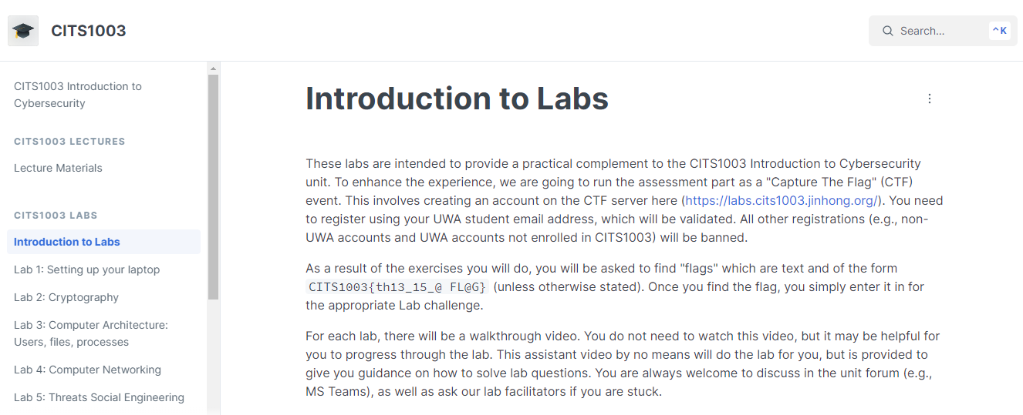
https://uwacyber.gitbook.io/cits1003/cits1003-labs/introduction-to-labs

Slide 7
Lab Location
Labs
Check your timetable for your lab allocation (https://studentvip.com.au/uwa/main/maps)
You may go to another scheduled lab IF there is a space (normally there is)

Slide 8
Lab Computer
The labs are related to docker, VirtualBox/VMware/UTM, Ubuntu OS, etc
As these virtualization software are NOT available on UWA lab machines, they must be run on your laptops
If you do not have a laptop that is capable of running the labs, you can arrange to borrow one: https://uwacyber.gitbook.io/cits1003/cits1003-labs/introduction-to-labs
Else – invest in a decent laptop – it will make a big difference to your University life.
If none of these options are available to you, please come and chat with me.

Slide 9
Lab Assessment
Labs are worth 25% of the final grade.
Each lab is worth 25 points
10 labs in total are worth 250 points.
Submission site: https://labs.cits1003.jinhong.org/

Slide 10
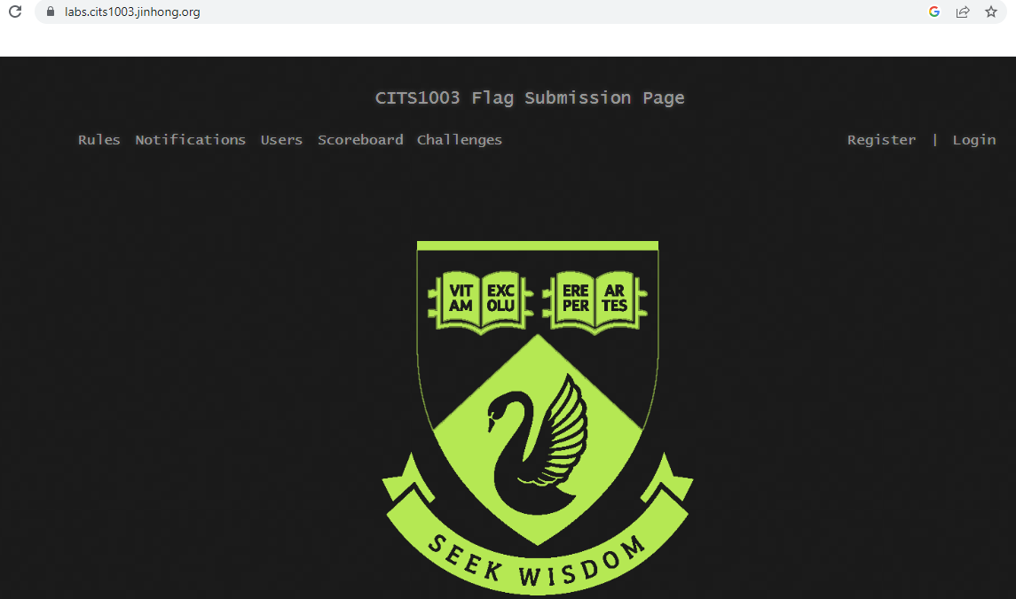
Submission Site

Slide 11
Lab Due Dates
Labs are due one week after the week they were scheduled

Slide 12
Lab Setup
Virtual Machine Manager: Vmware, Virtualbox, or UTM
Setup VM and do labs there to avoid any mistakes propagating to your host
VM provides an additional layer of security.

Slide 13
Other Assessments
Project will be released in Week 6 (tentative) and end in Week 11 (tentative). This will be similar in format to the labs – except without the guidance part
Project is worth 25% of final grade
Final Exam: 50% of final grade
Exam overview will be done in week 12.
Exam can be assisted by open-book notes without electronic materials

Slide 14
Weekly Topics
Introduction to overall definitions and concepts of cyber security
Cryptography: codes and ciphers
Computers and Networks
Threats
Vulnerabilities
Security management
Incidents
Forensics
Critical Infrastructure and Cyber Physical Systems
Cyber Law
AI and Cybersecurity

Slide 15
Online Resources
You may find David Glance’s book on Ethical Hacking with Hack The Box useful
https://hackingbook.cybermnemosyne.com/
Other useful online resources will be provided throughout the weeks as necessary.

